Slide 1
Driver development in Linux OS
By Maryam Hummatova

Slide 2
Introduction
In computing, a device driver is a computer program that operates or controls a particular type of device that is attached to a computer or automaton. A driver provides a software interface to hardware devices, enabling operating systems and other computer programs to access hardware functions without needing to know precise details about the hardware being used.
A driver communicates with the device through the computer bus or communications subsystem to which the hardware connects. When a calling program invokes a routine in the driver, the driver issues commands to the device. Once the device sends data back to the driver, the driver may invoke routines in the original calling program.
Drivers are hardware dependent and operating-system-specific.

Slide 3
Getting started with the Linux kernel module
The Linux kernel is written in the C and Assembler programming languages. C implements the main part of the kernel, while Assembler implements architecture-dependent parts. That’s why we can use only these two languages for Linux device driver development. We cannot use C++, which is used for the Microsoft Windows kernel, because some parts of the Linux kernel source code may include keywords from C++ , while in Assembler we may encounter lexemes such as ‘ : : ’.
When working with modules, Linux links them to the kernel by loading them to the kernel address space.

Slide 4
Creating a kernel module
We’ll start by creating a simple prototype of a kernel module that can be loaded and unloaded.

Slide 5
Registering a character device
Device files are usually stored in the/dev folder. They facilitate interactions between the user space and the kernel code. To make the kernel receive anything, you can just write it to a device file to pass it to the module serving this file. Anything that’s read from a device file originates from the module serving it.
There are two groups of device files:
Character files — Non-buffered files that allow you to read and write data character by character.
Block files — Buffered files that allow you to read and write only whole blocks of data.

Slide 6
The file_operations structure
If this structure contains functions that aren’t required for your driver, you can still use the device file without implementing them. A pointer to an unimplemented function can simply be set to 0. After that, the system will take care of implementing the function and make it behave normally. In our case, we’ll just implement the read function.
As we’re going to ensure the operation of only a single type of device with our Linux driver, our file_operations structure will be global and static.

Slide 7
The printk function
The printk function forms a string, which we add to the circular buffer. From there the klog daemon reads it and sends it to the system log. Implementing the printk allows us to call this function from any point in the kernel. Use this function carefully, as it may cause overflow of the circular buffer, meaning the oldest message will not be logged.
Our next step is writing a function for unregistering the device file. If a device file is successfully registered, the value of the device_file_major_number will not be 0. This value allows us to revoke the registration of a file using the unregister_chrdev function, which we declare in the linux/fs.h file. The major device number is the first parameter of this function, followed by a string containing the device name. The register_chrdev and the unresister_chrdev functions have similar contents.

Slide 8
Using memory allocated in user mode
The read function we’re going to write will read characters from a device.
The data we’ve read is allocated in the user space at the address specified by the second parameter — buffer.
Its name speaks for itself: it copies specific data from the kernel buffer to the buffer allocated in the user space.
This is done using Sparse, an analyzer for static code.

Slide 9
Building the kernel mode
In modern kernel versions, the makefile does most of the building for a developer.
It starts the kernel build system and provides the kernel with information about the components required to build the module.
A module built from a single source file requires a single string in the makefile. After creating this file, you only need to initiate the kernel build system with the obj-m := source_file_name.o command. As you can see, here we’ve assigned the source file name to the module — the *.ko file.
If there are several source files, only two strings are required for the kernel build:
obj-m := module_name.o
module_name-objs := source_1.o source_2.o … source_n.o

Slide 10
Loading and using the module
To load the module, we have to execute the make load command from the source file folder.
The first three records contain the name of the added device and the major device number with which it’s associated.
Then we need to create the special character file for our major number with the mknod /dev/simple-driver c 250 0 command.
To verify, we can use the cat command to display the device file contents:
$> cat /dev/simple-driver

Slide 11
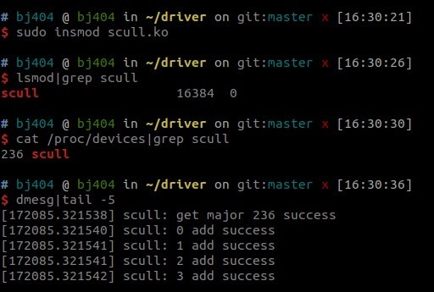
Add device files under /dev

Slide 12
Conclusion and Resources
We’ve shown you how to write a simple Linux driver. You can find the full source code of this driver in the Apriorit GitHub repository.
and
Linux Device Drivers, 3rd Edition by Jonathan Corbet, Alessandro Rubini, and Greg Kroah-Hartman
The Linux Kernel Module Programming Guide by Peter Jay Salzman, and Ori Pomeranz
Linux Cross Reference

